Slide 1
Population Health Modeling: Day 11

Slide 2

Check-In

Slide 3
Brief Review
Basic principles for public health research and modeling
Outbreak investigations
Everything you need to know about Streptococcus pneumoniae
Introduce time series analysis
Adapting your data, time series analysis
Introduce hierarchical modeling
Adapting your data, hierarchical modeling
Presenting your data and results, round 1

Slide 4
Brief Overview
Introduce Market Basket Analysis
Walk-through example
DIY Market Basket Analysis

Slide 5
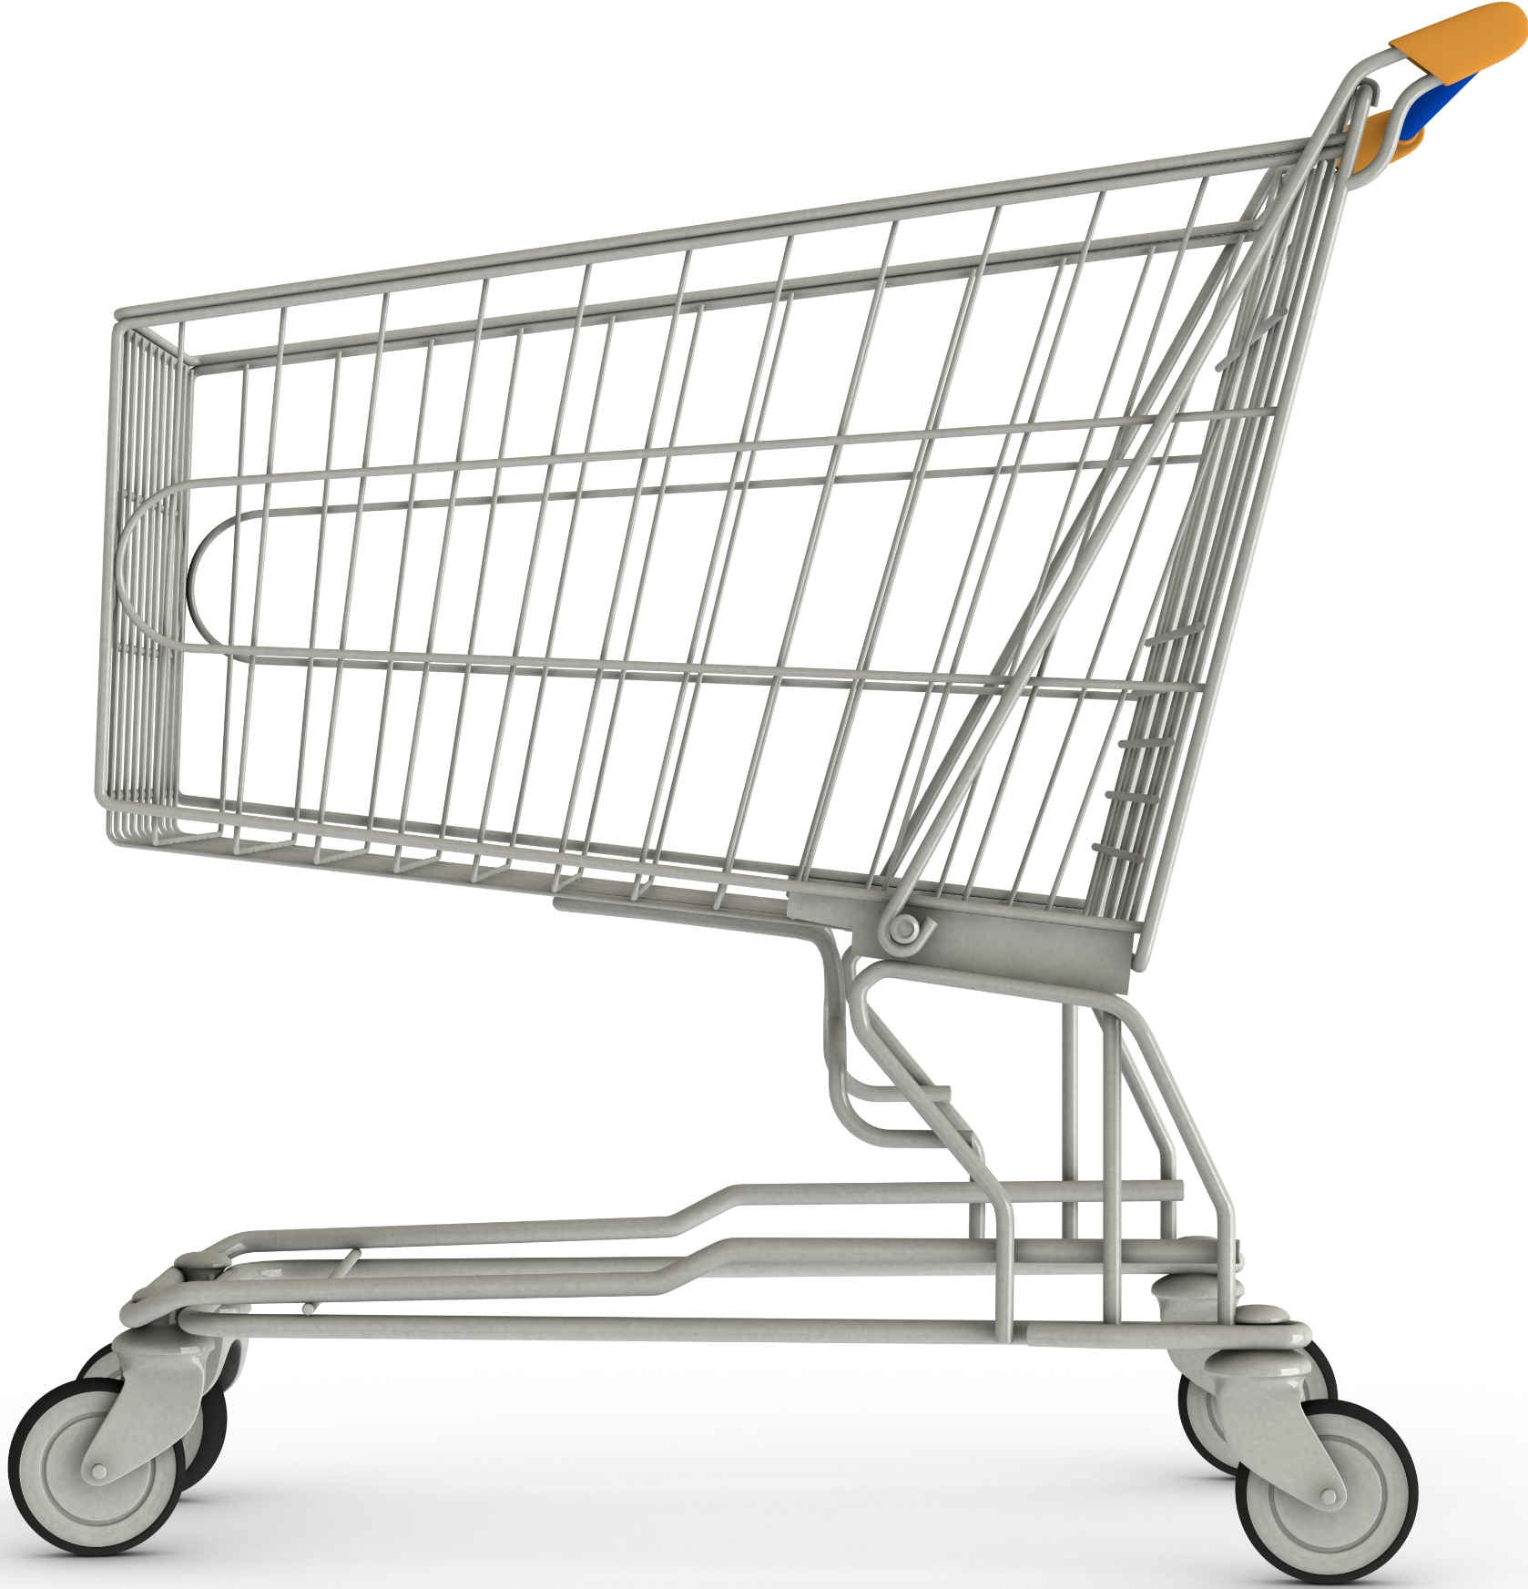
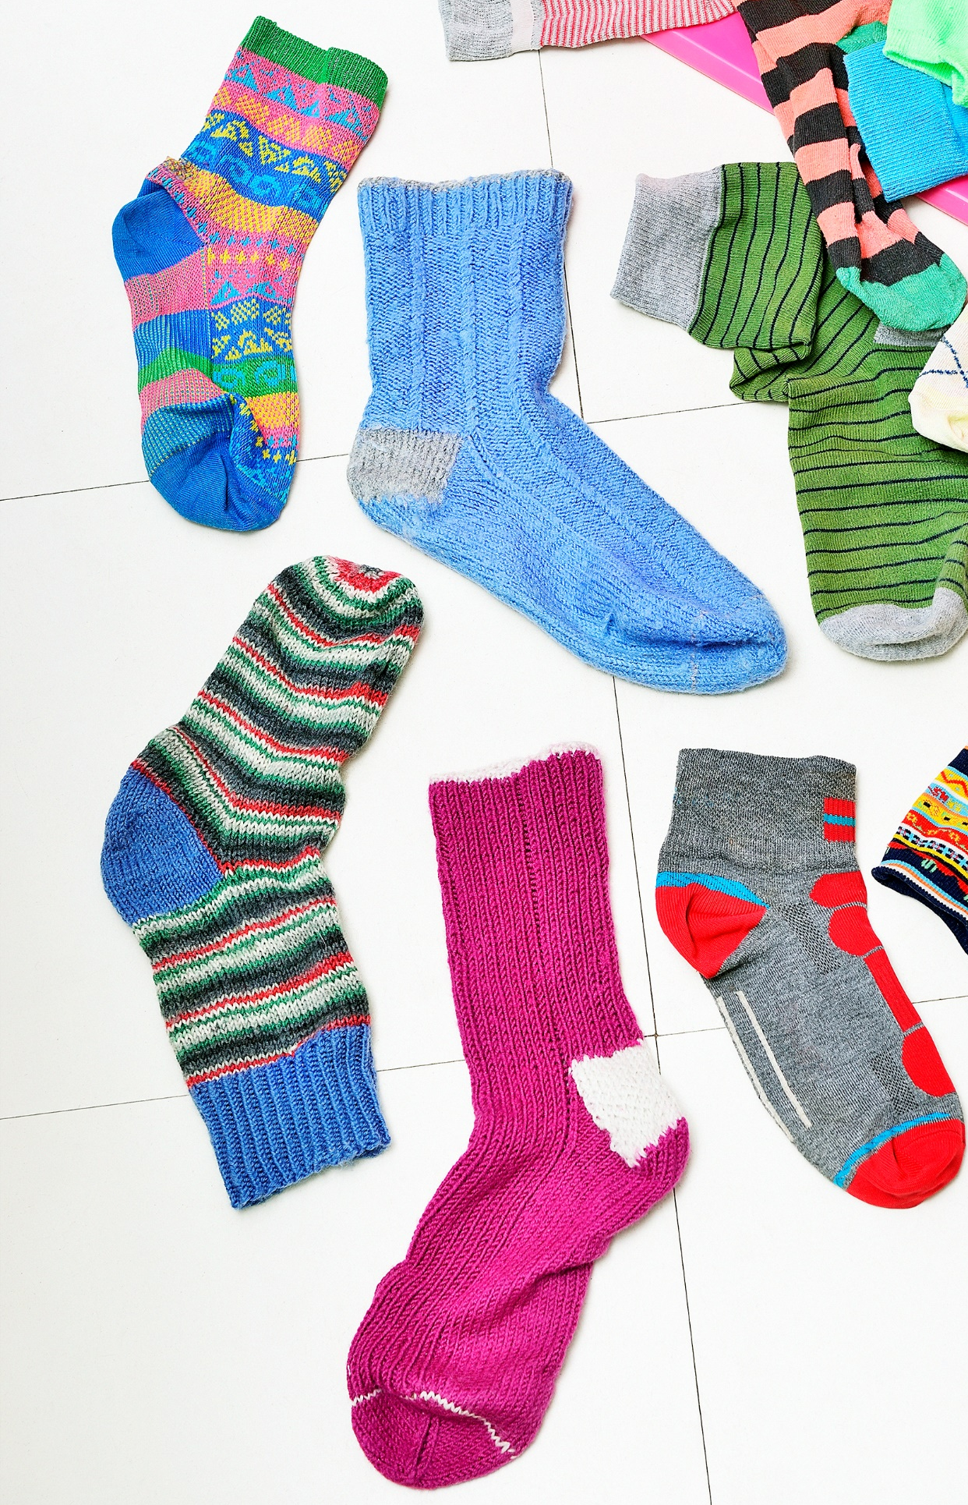
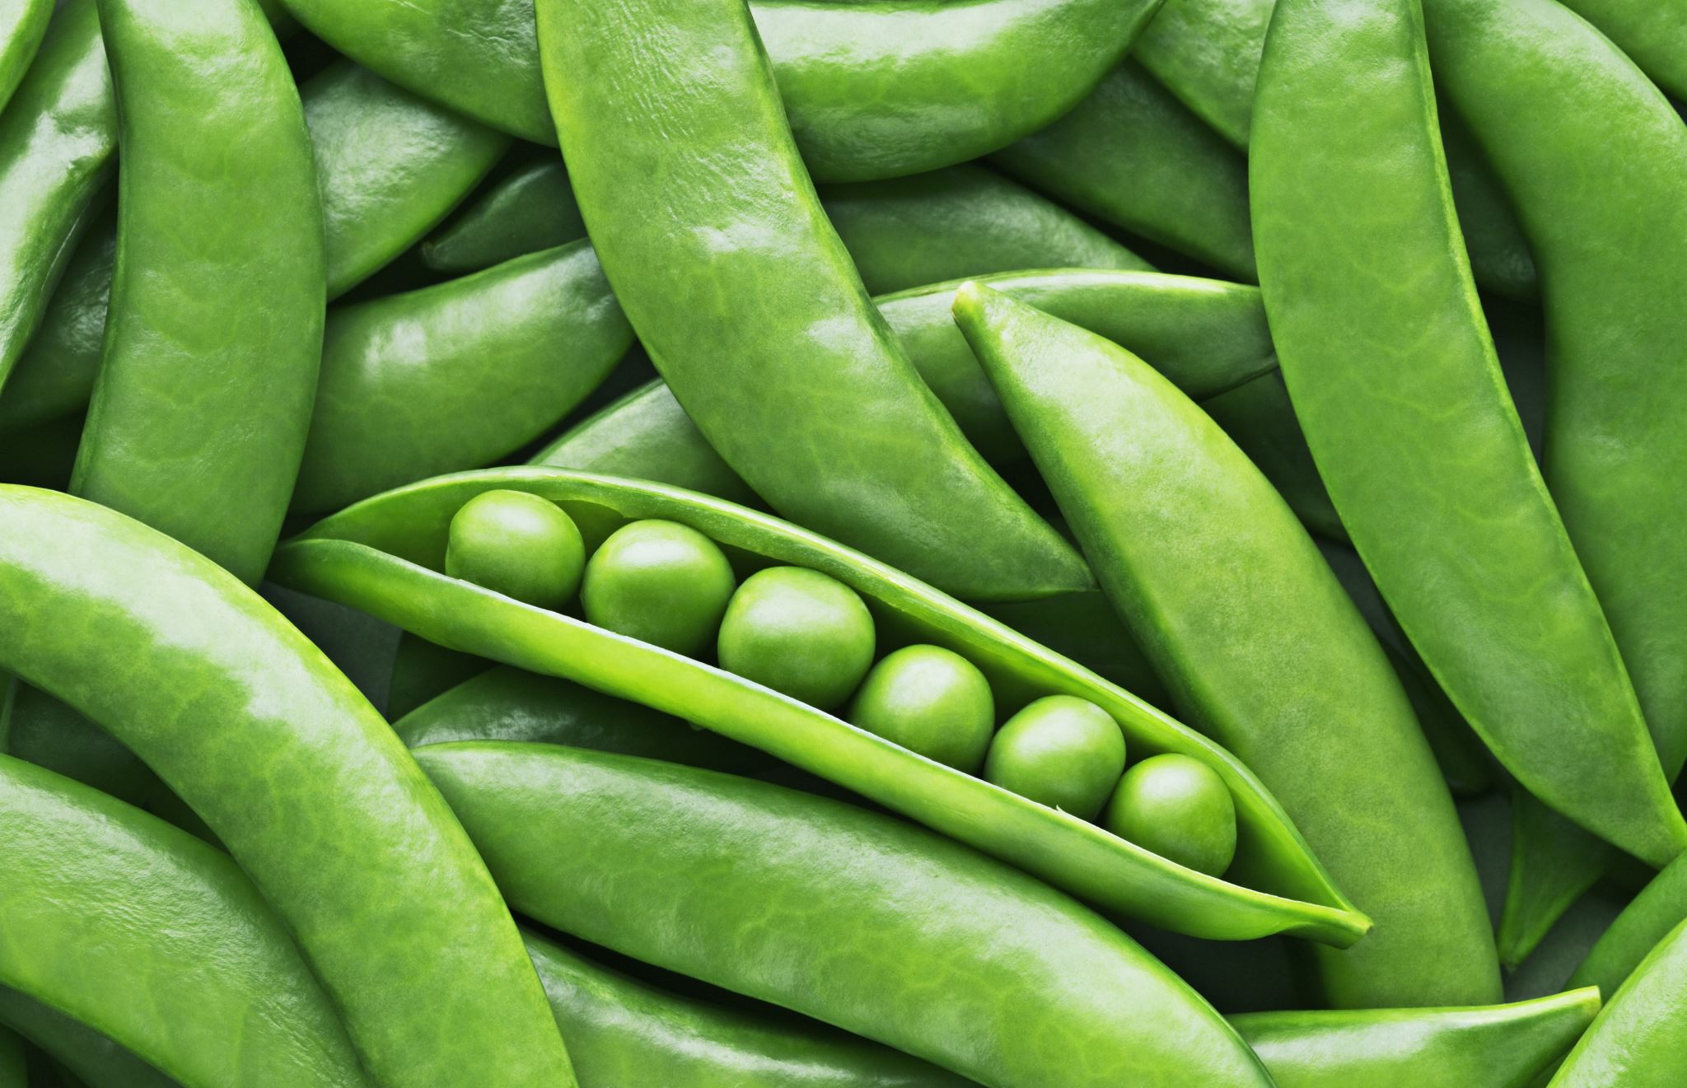
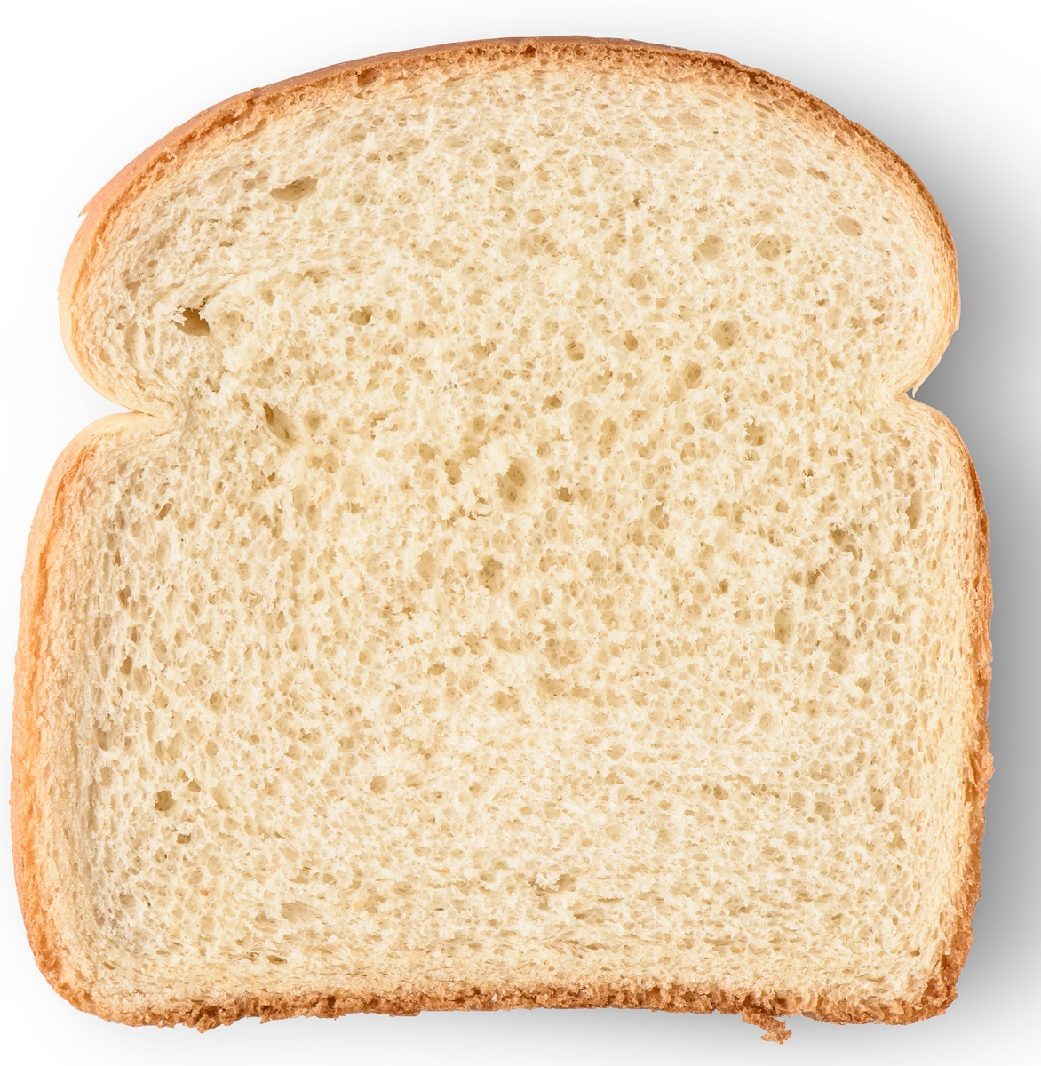

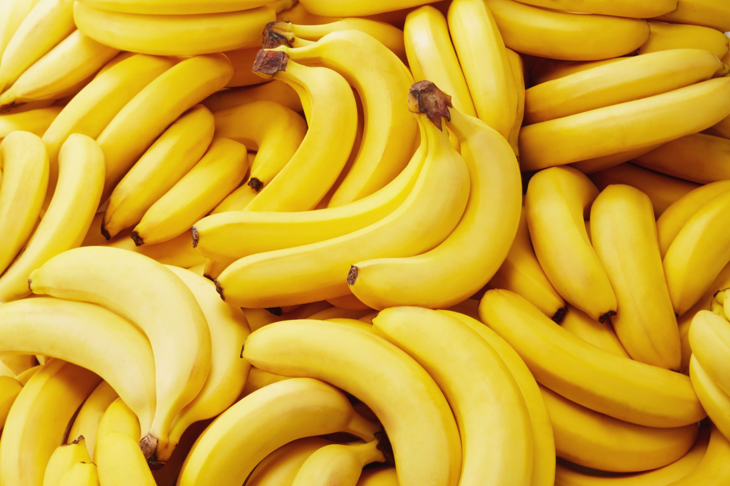
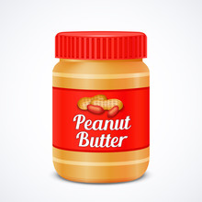

Association rules mining: Basics

Slide 6
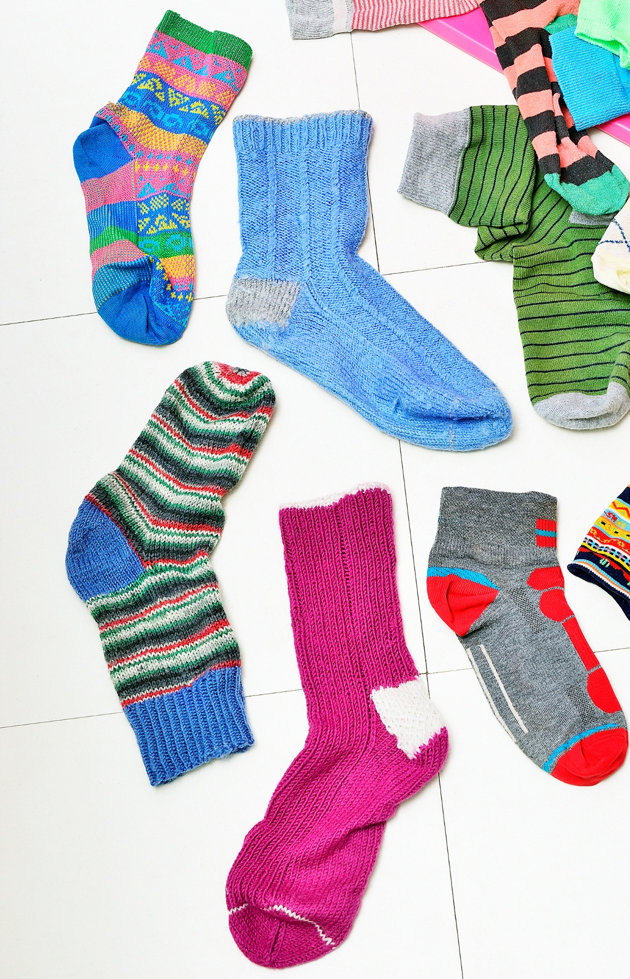

Association rules mining: Basics

Slide 7
Association rules mining: Basics
This is a rule:
Bread + Peanut Butter

Slide 8
Association rules mining: Basics

Slide 9
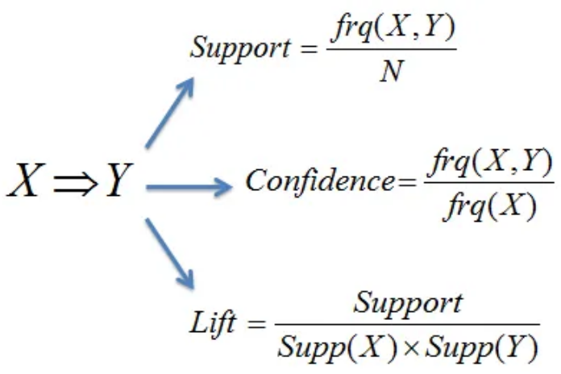
Association rules mining: Basics
Which rule is best?
3 criteria to evaluate:
Support
Confidence
Lift
Now there are three rules:
Bread + Peanut Butter
Bread + Peanut Butter + Bananas
Bread + Peanut Butter + Jelly

Slide 10
Deciding which rules are best
For a rule X => Y, where X is bread and Y is peanut butter:
Support: how often an item X appears in all transactions
Support{X} = X/N
Confidence: how often Y is purchased given that X is purchased in a transaction
Confidence {X=>Y} = Support {X,Y}/ Support{X}
Lift: how often Y is purchased given that X is purchased, controlling for popularity of Y
Lift {X=>Y} = Support {X,Y}/(Support{X} * Support{Y})
Notes:
Support
How often an itemset appears in a dataset. It's a measure of how popular an itemset is. For example, if 40 out of 100 transactions contain bread, then the support for bread is 40/100.
Confidence
The probability that an item will appear in a transaction if another item is also present. It's a measure of how reliable the inference made by a rule is. For example, if 20 out of 40 transactions that contain bread also contain butter, then the confidence for the rule "bread → butter" is 20/40 or 50%. This means that when bread is purchased, there's a 50% chance that butter will also be purchased.
Lift
The strength of an association between items, and how likely it is that two items will be purchased together more often than expected. Lift compares the observed confidence with the expected confidence, or how many times an if-then statement is expected to be true. For example, if the lift of {apple -> beer} is 1, this means there's no association between the two items. Lift values greater than 1 indicate a strong association.

Slide 11
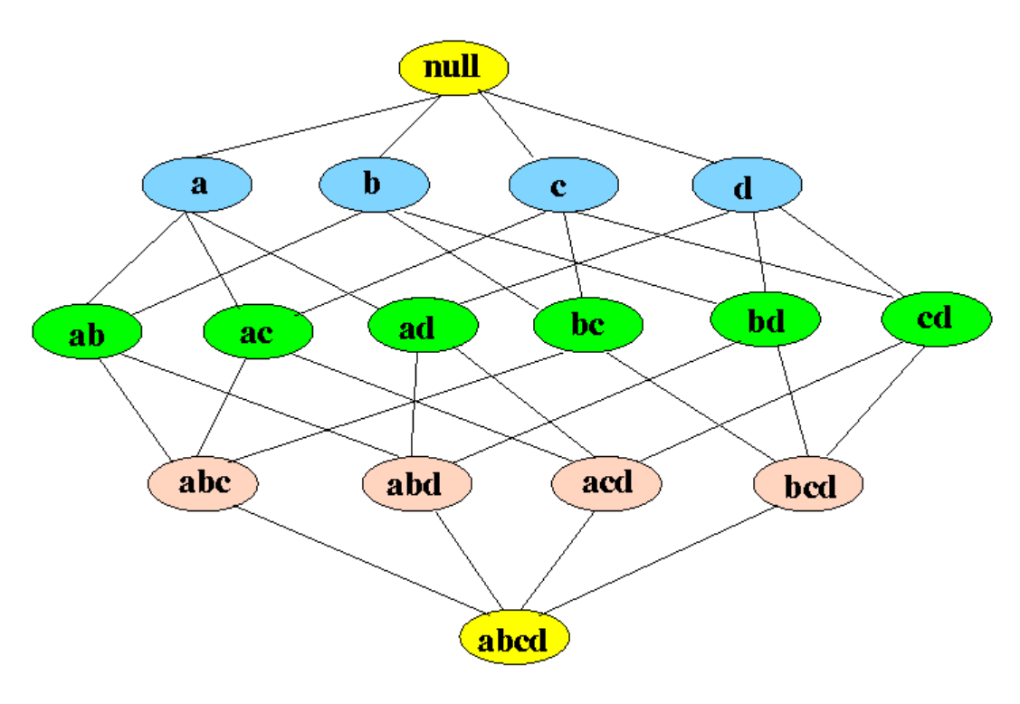
Many Rules are possible!
https://www.datacamp.com/community/tutorials/market-basket-analysis-r

Slide 12
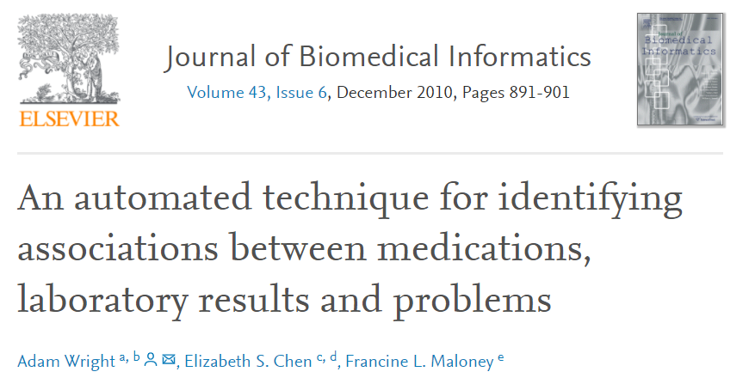
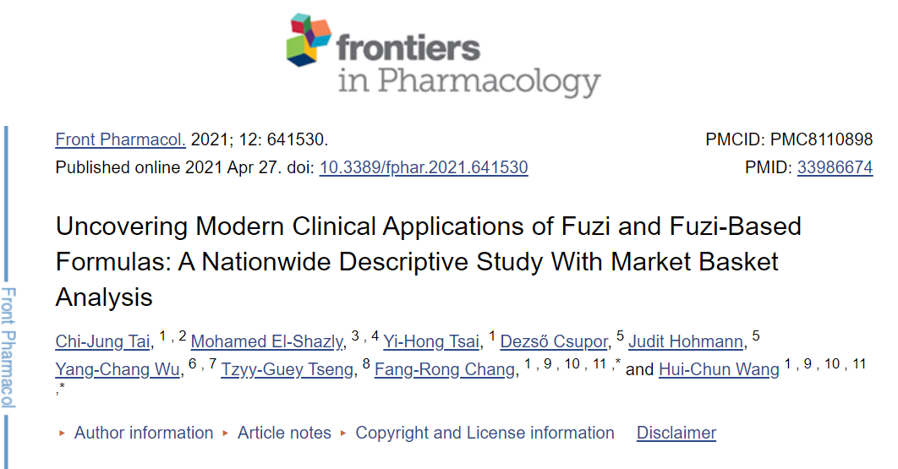
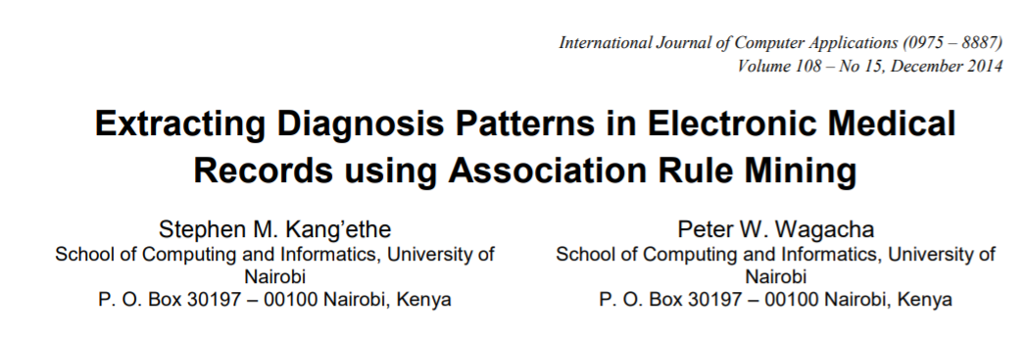
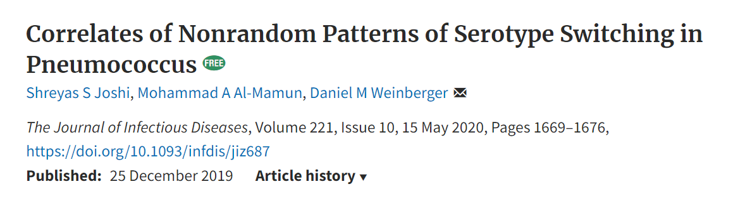
Market Basket Analysis for Health/Biology

Slide 13
Find New Associations!

Slide 14
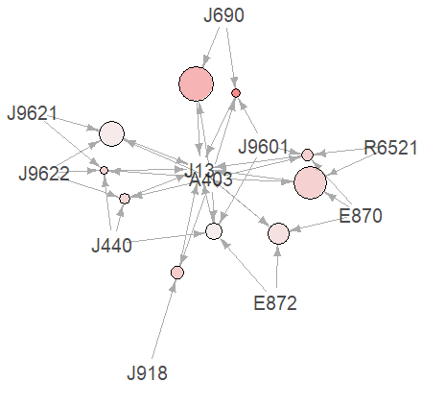
E.g. Identifying clinical factors associated with recurrence of pneumonia
ICD-10 code | Description
A403 | Sepsis due to Streptococcus pneumoniae
J9601 | Acute respiratory failure with hypoxia
R6521 | Severe sepsis with septic shock
E870 | Hyperosmolality and hypernatremia
E872 | Acidosis
J918 | Pleural effusion in conditions classified elsewhere
J440 | Chronic obstructive pulmonary disease with (acute) lower respiratory infection
J9622 | Acute and chronic respiratory failure with hypercapnia
J9621 | Acute and chronic respiratory failure with hypoxia
J690 | Pneumonitis due to inhalation of food and vomit

Slide 15

Market Basket Analysis Example
Perforating Acute Otitis Media in children
Pneumococcal AOM vs other bacterial or viral causes
VT Pneumococcal AOM vs other bacterial or viral causes
Pneumococcal AOM with NP carriage
Of pneumococcus, of other bacteria

